Slide 1

CMR COLLEGE OF ENGINEERING & TECHNOLOGY
Kandlakoya, Medchal, Hyderabad - 501401
Department of Computer Science and Engineering
BI-OBJECTIVE HYPER-HEURISTIC SUPPORT VECTOR MACHINES FOR BIG DATA CYBER-SECURITY
Batch No.:30
Name of the student:
20H51A05K4-Ch.Sridham
20H51A0512-G.Poojitha
20H51A05Q1-Imtiyaz Ahmad Wani
Under esteemed guidance of
Ms.G.Srividya
(Assistant Professor)
Batch: 2020-2024 Major Project Phase 1

Slide 2
Outline
Abstract
Introduction
Research Objective
Problem Definition
Scope of the Project
Literature Review
Implementation of Existing system
Conclusion
References
Notes:
2

Slide 3
Abstract
Notes:
3

Slide 4
ABSTRACT
Cyber security in the context of big data is known to be a critical problem and presents a great challenge to the research community. Machine learning algorithms have been suggested as candidates for handling big data security problems. Among these algorithms, support vector machines (SVMs) have achieved remarkable success on various classification problems.
However, to establish an effective SVM, the user needs to define the proper SVM configuration in advance, which is a challenging task that requires expert knowledge and a large amount of manual effort for trial and error.
In this paper, we formulate the SVM configuration process as a bi-objective optimization problem in which accuracy and model complexity are considered as two conflicting objectives. We propose a novel hyper-heuristic framework for bi-objective optimization that is independent of the problem domain. The proposed hyper-heuristic framework consists of a high-level strategy and low-level heuristics. The high-level strategy uses the search performance to control the selection of which low-level heuristic should be used to generate a new SVM configuration. The low-level heuristics each use different rules to effectively explore the SVM configuration search space.

Slide 5
INTRODUCTION
Notes:
5

Slide 6
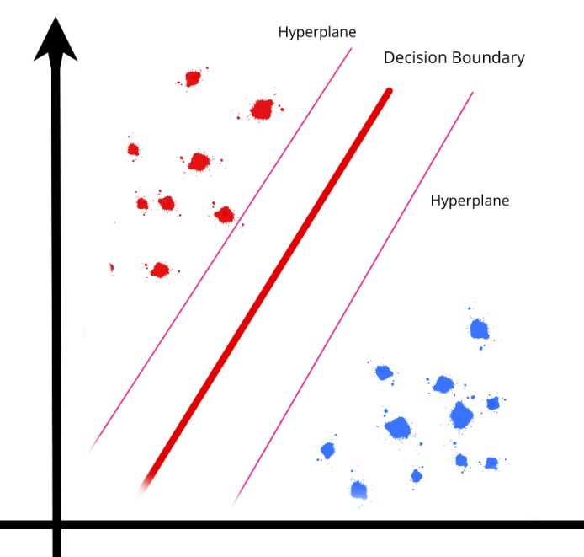
Introduction
Most of existing malware detection methods are mainly proposed to deal with small-scale datasets and unable to handle big data within a moderate amount of time. In addition, these methods can be easily evaded by attackers, very costly to to maintain and they have very low success rates.To address the above issues, machine learning (ML) algorithms have been proposed for classifying unknown patterns and malicious software
.
This work presents a novel bi-objective hyper-heuristic framework for SVM configuration optimisation. Hyper heuristics are more effective than other methods because they are independent of the particular task at hand and can often obtain highly competitive configurations.
Our proposed hyperheuristic framework integrates several key components that differentiate it from existing works to find an effective SVM configuration for big data cyber security.
Notes:
6

Slide 7
Research Objective
Notes:
7

Slide 8
Research objective
The primary objective of this project is to develop a novel Bi-objective Hyper-heuristic approach for Support Vector Machines (SVM) in the domain of big data cyber-security. The project aims to address the challenges associated with handling large-scale datasets efficiently while optimizing the detection rate of cyber threats and minimizing false positives simultaneously.
One objective is to investigate and design an algorithm that can automatically select the most suitable combination of hyper parameters and feature selection techniques for SVM. By leveraging hyperheuristics, the algorithm will intelligently search through a vast space of potential solutions, including different combinations of SVM hyper parameters, feature selection methods, and other pre-processing techniques. This objective will contribute to enhancing the accuracy of cyber threat detection by finding an optimal configuration that improves the performance of SVM on big data cyber-security datasets.
Another objective is to develop an approach that can handle the computational demands of big data analytics efficiently.

Slide 9
Problem Definition
Notes:
9

Slide 10
Problem Definition
Support Vector Machines (SVM) have emerged as a popular technique for addressing cyber-security challenges. However, the traditional SVM approach often struggles to handle large-scale datasets efficiently, leading to reduced accuracy and increased computational time. Moreover, cyber-security professionals face the challenge of balancing two conflicting objectives: maximizing the detection rate of cyber threats and minimizing false positives.
To address these issues, this project aims to develop a Bi-objective Hyper-heuristic approach for Support Vector Machines in the context of big data cyber-security. The project seeks to investigate and design an algorithm that can automatically select the most suitable combination of hyper parameters and feature selection techniques to optimize both the detection rate and minimize false positives.

Slide 11
Scope of the Project
Notes:
11

Slide 12
Scope of the Project
The project will involve exploring and developing novel hyper-heuristic algorithms that intelligently search through a large space of potential solutions, including different combinations of SVM hyper parameters, feature selection methods, and other pre-processing techniques.
The proposed approach will leverage the power of big data analytics to handle large-scale datasets efficiently,improving the accuracy of cyber threat detection while reducing computational time. By developing a bi-objective hyper-heuristic approach, this project aims to provide cyber-security professionals with a tool that can effectively and efficiently address the challenges of big data cyber-security.
The resulting approach will help improve the decision-making process by enabling security analysts to focus on genuine cyber threats while minimizing false positives, ultimately enhancing the overall cyber-security posture of organizations in the face of rapidly evolving cyber threats.

Slide 13
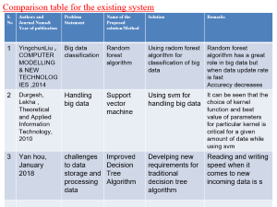
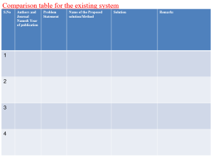
Literature Review
Notes:
13

Slide 14
Comparison table for the existing system
S.No | Authors and Journal Name& Year of publication | Problem Statement | Name of the Proposed solution/Method | Solution | Remarks
1 | YingchunLiu , COMPUTER MODELLING & NEW TECHNOLOGIES ,2014 | Big data classification | Random forest algorithm | Using radom forest algorithm for classification of big data | Random forest algorithm has a great role in big data but when data update rate is fast Accurecy decreases
2 | Durgesh, Lekha , Theoretical and Applied Information Technology, 2010 | Handling big data | Support vector machine | Using svm for handling big data | It can be seen that the choice of kernel function and best value of parameters for particular kernel is critical for a given amount of data while using svm
3 | Yan hou, January 2018 | challenges to data storage and processing data | Improved Decision Tree Algorithm | Develping new requirements for traditional decision tree algorithm | Reading and writing speed when it comes to new incoming data is s

Slide 15
Comparison table for the existing system
S.No | Authors and Journal Name& Year of publication | Problem Statement | Name of the Proposed solution/Method by authors | Solution | Remarks
4 | Soha Safwat, Osman Hegazy, International Journal of Computer Application, 2015 | Effective analysis of big data | Fuzzy K-Nearest Neighbor | Analyzing big data using Fuzzy K-Nearest Neighbor classifier | K-NN's performance can degrade in high-dimensional spaces

Slide 16
Implementation of Existing System
SVMs are a class of supervised learning models that have been widely used for classification and regression SVMs are based on statistical learning theory and are better able to avoid local optima than other classification algorithms. An SVM is a kernel-based learning algorithm that seeks the optimal hyper plane. The existing kernel functions can be classified as either local or global kernel functions. Local kernel functions have a good learning ability but do not have good generalization ability. the feature space distribution is not known in advance and may change during the course of the solution process, especially in big data cyber security. Consequently, different kernel functions may work well for different instances or in different stages of the solution process and kernel selection may thus have a crucial impact on SVM performance. To address this issue, in this work, we use multiple kernel functions to improve the accuracy of our algorithm and avoid the shortcomings of using a single kernel function
DISADVANTAGES OF EXISTING SYSTEM:
Limited Scalability
Lack of Automatic Hyper Parameter Selection

Slide 17
Result
The proposed methodology has two parts: the SVM and the hyper-heuristic framework. The main role of the hyper-heuristic framework is to generate a configuration (C, kernel type and kernel parameters) and send it to the SVM. The SVM uses the generated configuration to solve a given problem instance and then sends the cost function (mean values of err and NSV ) to the hyper-heuristic framework. This process is repeated for a certain number of iterations.

Slide 18
Conclusion
The proposed system, a Bi-objective Hyper-heuristic approach for SVM in big data cybersecurity, aims to overcome these limitations. By leveraging hyper-heuristics, the proposed system will automatically select optimal hyper parameters and feature selection techniques, improving the accuracy and efficiency of SVM-based cyber-security systems. Additionally, the bi-objective optimization framework will balance the detection rate of cyber threats with the minimization of false positives, providing security analysts with a decision support tool. The development of the proposed system represents an important step towards enhancing the cyber-security posture of organizations in the era of big data. By addressing the limitations of existing systems, the proposed approach has the potential to improve the scalability, adaptability, and decision-making capabilities of cyber-security systems, leading to more effective threat detection and prevention.

Slide 19
References
● N. R. Sabar, X. Yi and A. Song, "A Bi-objective Hyper-Heuristic Support Vector Machines for Big Data Cyber-Security," in IEEE Access, vol. 6, pp. 10421-10431, 2018, doi: 10.1109/ACCESS.2018.2801792.Herbert Schildt, Edition (2003) ‘The Complete Reference JAVA 2’ Tata McGraw Hill Publications
● M. Ahmadi, D. Ulyanov, S. Semenov, M. Trofimov and G. Giacinto, "Novel feature extraction selection and fusion for effective malware family classification", Proc. 6th ACM Conf. Data Appl. Secur. Privacy, pp. 183-194, 2016.Michael Foley and Mark McCulley, Edition(2002) ‘JFC Unleashed’ Prentice-Hall India
● M. P. Basgalupp, R. C. Barros and V. Podgorelec, "Evolving decision-tree induction algorithms with a multi-objective hyper-heuristic", Proc. 30th Annu. ACM Symp. Appl. Comput., pp. 110-117, 2015.
● E. K. Burke, M. Hyde, G. Kendall, G. Ochoa, E. Özcan and J. R. Woodward, "A classification of hyperheuristic approaches" in Handbook of Metaheuristics, Boston, MA, USA:Spri

Slide 20
Thank You!

